Slide 1
Building on your AMS Foundation…Allergies, Micro, and Antibiograms
AAHP Fall Seminar 2018
Barry Napier, PharmD, RN, EMT-P
Katherine Lusardi, PharmD, BCPS-AQ ID
Marsha Crader, PharmD

Slide 2
Learning Objectives
Recognize structural side chain similarities consistent with beta-lactam allergies
Explain graded challenge procedures and when they are appropriate
Summarize pharmacy’s role in beta-lactam skin testing
Describe how microbiology processes and changes impact antimicrobial stewardship (AMS) and antibiograms
Design AMS activities based on minimum inhibitory concentration (MIC) changes
Discuss AMS examples that have led to improvement in MICs and resistance rates

Slide 3
AMS and Allergies

Slide 4
Evaluation of β-lactam allergy

Slide 5
Case
63 yo M
PMH: laparotomy, gastrojejunostomy, and serosal repair performed for gastric outlet obstruction (2016)
Last outpt clinic visit (4 mo previous): “with long standing hx of gastroparesis and weight loss who in 2016 had gastrojejunostomy and J tube placement for c/o abd pain from prev gastric stimulator”
Last hospital admission: 19 months previous
Prev abx Hx: clindamycin po x 7d (7 months ago)
Complicated post-op course

Slide 6
Day 8
Collection sample: TRACHEAL ASPIRATE Collection date: xxxx
Site/Specimen: TRACHEAL CYTOLOGIC MATERIAL
Test(s) ordered: CULTURE (TRACHEAL ASPIRATE)... completed: xxxx
Reported: Jul 26, 2018 1+ GRAM NEGATIVE BACILLI
CULTURE RESULTS: KLEBSIELLA PNEUMONIAE SSP PNEUMONIAE - Quantity: 3+
SUSC INTP
AMIKACIN...................... <=2 S
AMPICILLIN.................... >=32 R
CEFAZOLIN..................... <=2 S
TRIMETHOPRIM/SULFA............ <=20 S
IMIPENEM...................... <=0.25 S
CIPROFLOXACIN................. <=0.25 S
AMPICILLIN/SULBACTAM 4 S
LEVOFLOXACIN.................. <=0.12 S
CEFEPIME...................... <=1 S
PIPERACILLIN/TAZOBACTAM....... <=4 S
CEFTAZIDIME................... <=1
CEFTRIAXONE1.................. <=1 S
ESBL.......................... Neg -

Slide 7
Day 31 (day 15 meropenem))
Collection sample: BLOOD CULTURE Site/Specimen: (growth identified in PICC line and L.A.-line)
* BACTERIOLOGY FINAL REPORT => KLEBSIELLA PNEUMONIAE, CARBAPENEM RESISTANT (CRE)
Comment: ESBL Confirmed
KPC CARBAPENAMASE GENE DETECTED
CONFIRMED BY XPERT CARBA-R PCR ASSAY
SUSC INTP
AMIKACIN...................... <=2 S
AMPICILLIN.................... >=32 R
CEFAZOLIN..................... >=64 R
TRIMETHOPRIM/SULFA............ <=20 S
GENTAMICIN.................... <=1 S
IMIPENEM...................... R R
CIPROFLOXACIN................. <=0.25 S
AMPICILLIN/SULBACTAM (UNASYN). >=32 R
LEVOFLOXACIN.................. <=0.12 S
CEFEPIME...................... <=1 R
PIPERACILLIN/TAZOBACTAM....... >=128 R
CEFTAZIDIME................... 4 R
CEFTRIAXONE1.................. 8 R
ESBL.......................... Pos +
Notes:
Also in peritoneal fluid and urine

Slide 8
Trubiano, Jason A., N. Franklin Adkinson, and Elizabeth Jane Phillips. "Penicillin allergy is not necessarily forever." Jama318.1 (2017): 82-83.
Background:
10% of population has PCN allergy listed in medical records, yet it is estimated that <1% have a true IgE mediated (type 1) allergy.
Of those that have had a true allergy, approximately 80% will have lost this sensitization within 10 years.
Charted PCN allergy has been associated with increased morbidity, including increased length of hospital stay, increase costs, and increased exposure to broad spectrum abx, placing patient at risk for developing resistance.
No proven alternatives to penicillin are available for treating neurosyphilis, congenital syphilis, or syphilis in pregnant women.

Slide 9
Pharmacy and Therapeutics, August 2018 Vol 3 No 8 (480-484)

Slide 10
Information to be Obtained When Taking a History of Antibiotic Allergy
Concerns regarding the reaction include the following:
• Timing of the reaction in relation to drug administration
• Symptoms and evolution of the reaction
• Description of cutaneous symptoms (e.g., maculopapular, urticarial, bullous)
• Involvement of mucosal surfaces or internal organs
• Treatment administered, response, and duration of reaction
• History of prior exposure to the implicated agent
• Other medications ingested at the time of the reaction
• Was the medication or similar medications taken (and tolerated) thereafter?
• Are there potential confounders (e.g., underlying viral or bacterial infections)?
• History of other drug reactions and allergies (many patients with multiple drug intolerance syndrome do not have true drug allergies)
• Has the patient experienced recurrent, similar reactions without known exposures (e.g., chronic urticaria)?
Pharmacy and Therapeutics, August 2018 Vol 3 No 8 (480-484)

Slide 11
Pharmacy and Therapeutics, August 2018 Vol 3 No 8 (480-484)

Slide 12
Pharmacy and Therapeutics, August 2018 Vol 3 No 8 (480-484)

Slide 13
Penicillin Allergy Clarification Project
Student-led project for admitted patients
Assessment completed for all patients with a documented penicillin allergy on an antibiotic
Nurse completes assessment for all pre-op patients during pre-op appointment
Patients provided an education sheet after all interviews
Results uploaded onto EHR
Procedure approved through CNO council and Antimicrobial Stewardship Committee
Brooke A. Johnson, PharmD | Antimicrobial Stewardship Pharmacist | Northwest Health | 609 W. Maple Ave. Suite 405 | Springdale, AR 72764 | Phone 479-757-4587 | BJohnson@nw-health.com
Notes:
1. Students are taken on rounds on the floor and conduct the patient interviews under the supervision of a preceptor (4th year only)
2. All patients are required to have a pre-op appointment prior to their surgery where the assessment is completed along with traditional pre-op recommendations
3. Data is queried through Sentri7, but other clinical intervention software exists and would probably support this kind of data search
4. Program started about a year ago

Slide 14
Post- Implementation Review
Successes
Challenges
~35% of patients able to have penicillin allergy removed from chart
417 patients counseled since program implementation
50% reduction in fluoroquinolone use
Educating physicians to review allergy details prior to prescribing antibiotics
Building nursing support on the front end
Time constraints
Patient memory
Brooke A. Johnson, PharmD | Antimicrobial Stewardship Pharmacist | Northwest Health | 609 W. Maple Ave. Suite 405 | Springdale, AR 72764 | Phone 479-757-4587 | BJohnson@nw-health.com
Notes:
Successes
Removed allergy according to the algorithm as not a true allergy. Patients always approve the removal of the allergy. #1 reason allergies are removed are because they are actually side effects (mostly GI upset).
Biggest success is the reduction in fluoroquinolone use. Can not be 100% attributed to the penicillin allergy program; however, biggest contributor to the reduction is the penicillin allergy program. Percentage is based on drug spend.
Challenges
Physicians scan the patient allergies without looking into specific reactions which requires a few extra “clicks” into the chart.
Time constraints for pre-op nurses and pharmacy labor during months without pharmacy students
Sometimes difficult to for patient to remember specific reaction when can hinder the interview

Slide 15
Cross-reactivity
“Although the shared b-lactam ring of penicillins and cephalosporins is not predictive of cross-reactivity, a considerable body of evidence has established that cross reactivity between different cephalosporins and between cephalosporins and penicillins is dependent on the side chain structure of these agents.”
Pichichero ME “Use of selected cephalosporins in penicillin-allergic patients: a paradigm shift.” Science Direct 57 (2007) 13S-18S)
Notes:
Analysis of pooled data from 23 studies (1963 – 1997) with approximately 2400 patients with a reported history of penicillin allergy
and about 39 000 patients with no such history showed that the risk of cross-reactivity was related to side chain configuration and correspondingly to cephalosporin generation.
In these 23 studies, about 2200 patients had the presence of penicillin allergy evaluated by skin testing. The 1st generation cephalosporins included in the evaluation generally
share a chemical side chain similar to penicillin or amoxicillin. Analysis showed that the attributable risk of an allergic reaction to cephalosporins in penicillin allergic patients was increased by about 0.5% with the 1st-generation agents (P b 0.0001). In calculating attributable risk, the 3-fold increased risk of allergic reactions in penicillin-allergic patients to nonrelated drugs is taken into consideration (Smith et al., 1966). Second- and 3rd-generation cephalosporins generally have different side chains from penicillin and amoxicillin, and these agents were not associated with any increased risk of cross-reactivity with penicillin; cross-reactivity rates ranged from 0.8% to 0.2% (Pichichero, 2005). There was also no increased risk of anaphylaxis to cephalosporins in penicillin-allergic patients (Pichichero, 2005).

Slide 18
Antunez C. “Immediate-Allergic Reactions to Penicillins – Evaluation of Cross Reactivity with a Panel of Penicillins and Cephalosporins J Allergy Clin Immunology 2006;117:404-10
Notes:
Cristina Antunez, Spain
From athe Research Laboratory for Allergic Diseases and bthe Allergy Service,
Carlos Haya Hospital; and the Organic Chemistry Department, Malaga
University.
Supported by Fondo Investigacion Sanitaria grants FIS PIO20666 and CIYIT
BQU2001-3624.
Received for publication June 3, 2005; revised October 7, 2005; accepted
for publication October 28, 2005.
Reprint requests: Maria Jose Torres Jaen, MD, PhD, Allergy Service, Hospital
Civil, Plaza Hospital Civil s/n, 29009 Malaga, Spain. E-mail: mariaj.torres.
sspa@juntadeandalucia.es.
0091-6749/$32.00
2006 American Academy of Allergy, Asthma and Immunology
doi:10.1016/j.jaci.2005.10.032

Slide 19
Mandell, Douglas and Bennett “Principles and Practice of Infectious Disease” – 8th ed 2014

Slide 20
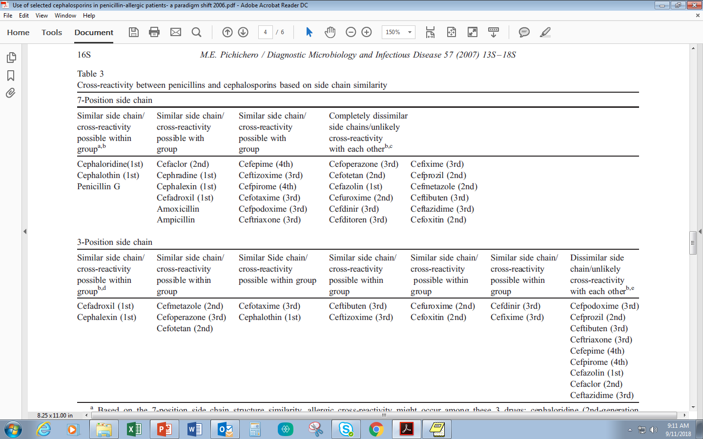
(Pichichero ME Use of selected cephalosporins in penicillin-allergic patients: a paradigm shift. Science Direct 57 (2007) 13S-18S)
Notes:
a Based on the 7-position side chain structure similarity, allergic cross-reactivity might occur among these 3 drugs: cephaloridine (2nd-generation
cephalosporin), cephalothin (1st-generation cephalosporin), and penicillin. The same interpretation applies to subsequent 4 columns.
b To apply this table clinically, check the antibiotic for cross-reactivity possibilities based on both the 7-position and 3-position side chains. If either side
chain position is shared between antibiotics to avoid a possible cross-allergy reaction to be considered, such use would not be recommended. If neither of the
side chains shares structured similarity between antibiotics, then cross-reactivity is highly unlikely and such antibiotics can be recommended without
anticipated increased risk of a cross-allergy reaction.
c Based on the 7-position side chain structure uniqueness, allergic cross-reactivity would be highly unlikely for all of these cephalosporins with each other
and with all other cephalosporins as well as penicillins.
d Based on the 3-position side chain structure similarity, allergic cross-reactivity might occur between these 2 drugs: cefadroxil (1st-generation
cephalosporin) and cephalexin (1st-generation cephalosporin). The same interpretation applies to the subsequent 6 columns.
e Based on the 3-position side chain structure uniqueness, allergic cross-reactivity would be highly unlikely for all these cephalosporins with each other and
with all other cephalosporins as well as penicillins.

Slide 21
Graded Challenge (“Allergy Provocation Test”)
Generally accepted as the gold standard to establish tolerance to a drug
Recommended when the probability is determined to be low for a true drug allergy based on the history and available diagnostic tests
Allows drug hypersensitivity to be excluded in a large % of patients
Persons with a history of severe non-IgE-mediated reactions (e.g., Stevens-Johnson syndrome, toxic epidermal necrolysis, interstitial nephritis, and hemolytic anemia) are not candidates for skin testing or challenge and should avoid penicillins indefinitely
Begin with 1/100th of therapeutic dose. Escalate every 30-60min to 1/10th dose, then the final therapeutic dose
Mandell, Douglas and Bennett “Principles and Practice of Infectious Disease” – 8th ed 2014

Slide 22
β-lactam allergy skin testing (BLAST)
Persons at high risk for anaphylaxis…
“In these situations, testing should be performed in a monitored setting in which treatment for an anaphylactic reaction is available. If possible, antihistamines… should not have been taken within 5 days of skin testing.”
Dilute the antigens in saline either 100-fold for preliminary testing (if the patient has had a IgE- mediated reaction to penicillin) or 10-fold (if the patient has had another type of immediate, generalized reaction to penicillin within the preceding year).

Slide 23
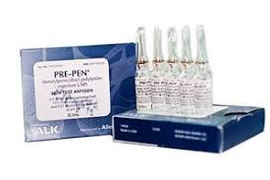
https://www.youtube.com/watch?v=Ie3oiT39s48

Slide 24
Advantages/Disadvantages of Penicillin Allergy Skin Testing
Advantages:
Decreases empiric therapy (less MDR)
Optimal therapy with better clinical outcomes
Takes less than 2 hours to get results of tests
Decreases in hospital and patient expenses
(avoiding expensive broad spectrum antibiotics)
Reduces C. difficile occurrences
Disadvantages:
Not always considered appropriate in critical care settings
Need ID team to perform efficiently
Labor intensive process
Brooke A. Johnson, PharmD | Antimicrobial Stewardship Pharmacist | Northwest Health | 609 W. Maple Ave. Suite 405 | Springdale, AR 72764 | Phone 479-757-4587 | BJohnson@nw-health.com

Slide 25
CID 2017:65 (1 October) • 1059
386 patients
232 (60%) received preferred B-lactam after ASP/ID assessment
154 (40%) eligible for BLAST
64 (42%) excluded
5 (8%) hx of severe non-IgE-mediated rcns
documented IgE rcn w/in past 3mo
22 (34%) discharged w/in 24 hrs of assessment
13 (20%) refused consent
10 (16%) nonpreferred agent became preferred agent
90 (58%) underwent BLAST
85 (94%) negative result
1 (1%) positive result
4 (4%) non-diagnostic (histamine prick test negative)
All 85 with negative BLAST tolerated B-lactam challenge
84 (99%) switched to preferred B-lactam
therapy w/o incident
1 (1%) developed non-severe rash day 1
Notes:
Among 386 patients during the intervention period, 232 (60%) received preferred β-lactam therapy following ASP/ID assessment during the intervention period while 154 (40%) were eligible for β-lactam allergy skin testing (BLAST). Among these, 64 (42%) were excluded: 5 (8%) with history of severe non-IgE-mediated reactions, 14 (22%) with documented IgE-mediated reaction within the prior 3 months, 22 (34%) who were being discharged within 24 hours of assessment, 13 (20%) who refused to consent, and 10 (16%) whose nonpreferred therapy became the preferred treatment for management of their infection based on follow-up clinical or microbiologic information. The remaining 90 (58%) eligible patients underwent BLAST, of whom 85 (94%) were negative, 4 (4%) were nondiagnostic (histamine prick test negative), and 1 (1%) was positive. All 85 patients with negative BLAST tolerated the β-lactam challenge and 84 were switched to preferred β-lactam therapy, of whom 1 (1%) developed a non-severe rash 1 day later requiring discontinuation and 83 (99%) tolerated β-lactam course without any immediate complications.

Slide 26
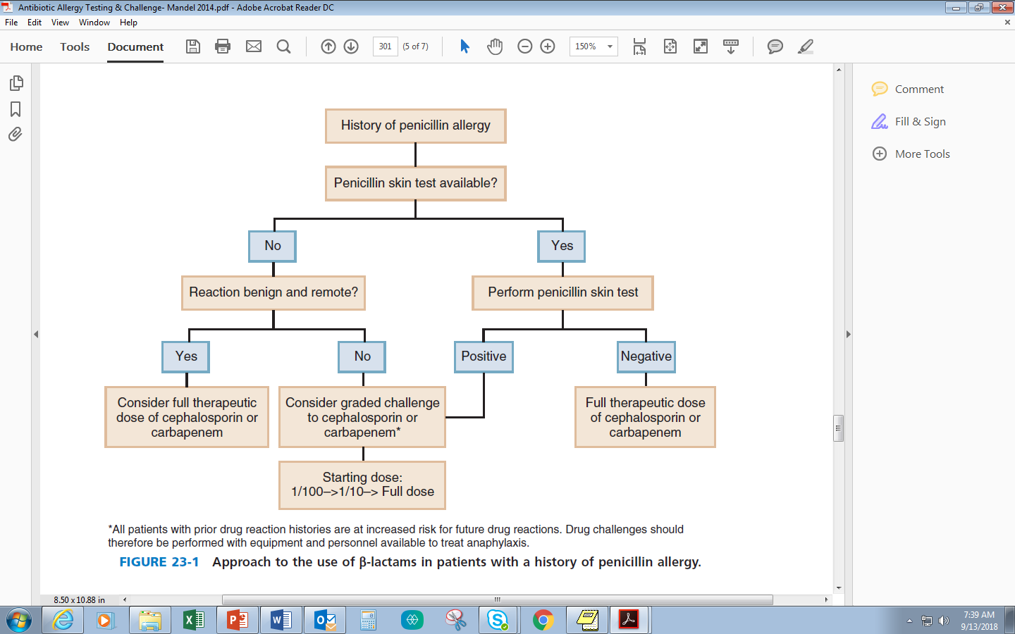
Mandell, Douglas and Bennett “Principles and Practice of Infectious Disease” – 8th ed 2014

Slide 27
Questions
All the following symptoms are consistent with immunologic drug allergy except:
A. Rash
B. Swelling
C. Shortness of breath
D. Nausea/vomiting

Slide 28
Questions
2. Which of the following cephalosporins share similar molecular structure to ampicillin and may result in cross-reactivity allergy symptoms:
A. Cefuroxime
B. Cefaclor
C. Cefdinir
D. Cephalexin

Slide 29
Thank You!
Special thanks to Brooke Johnson, PharmD, Northwest Health
Contact information
Barry Napier, PharmD, RN, EMT-P
Clinical Pharmacy Specialist – Infectious Diseases
barry.napier@va.gov

Slide 30
AMS and Microbiology

Slide 31
The 4 W’s
What
Who
When
Why

Slide 32
What: Minimum Inhibitory Concentration
Concentration at which bacterial
growth is inhibited
“Breakpoints” are the concentrations
that determine susceptible,
intermediate and resistant
Bug
MIC
Drug
Infection Site
Kuper KM, et al. Pharmacotherapy. 2009; 29(11): 1326-43.

Slide 33
Who: MIC Breakpoints
FDA Breakpoints
Initially set during antibiotic approval
All antibiotics have approved breakpoints in the PI
Automated susceptibility testing (AST) machines MUST use these
If the bug/drug concentration is not FDA approved, there will not be PI breakpoints
Kuper KM, et al. Pharmacotherapy. 2009; 29(11): 1326-43.

Slide 34
Who: MIC Breakpoints
CLSI Breakpoints
US based not for profit organization
Reviews breakpoints yearly
Published in the CLSI M100
Breakpoints are recommendations, but FDA and AST do not have to follow
EUCAST Breakpoints
European based
Kuper KM, et al. Pharmacotherapy. 2009; 29(11): 1326-43.)

Slide 35
When: Enterobacteriaceae Breakpoint Timeline
Prior CLSI/FDA
CLSI
FDA
Antibiotic | S | I | R | S | I/DD | R | S | I | R | Year of last CLSI update | Year of last FDA update
Aztreonam | ≤ 8 | 16 | ≥ 32 | ≤ 4 | 8 | ≥ 16 | ≤ 4 | 8 | ≥ 16 | 2010 | 2013
Cefazolin urine | ≤ 8 | 16 | ≥ 32 | ≤ 2 ≤ 16 | 4 | ≥ 8 ≥ 32 | ≤ 1 n/a | 2 | ≥ 4 n/a | 2011 | 2015
Cefepime | ≤ 8 | 16 | ≥ 32 | ≤ 2 | 4-8 (SDD) | ≥ 16 | ≤ 2 | 4-8 | ≥ 16 | 2014 | 2014
Ceftriaxone | ≤ 8 | 16-32 | ≥ 64 | ≤ 1 | 2 | ≥ 4 | ≤ 1 | 2 | ≥ 4 | 2010 | 2015
Ceftazidime | ≤ 8 | 16 | ≥ 32 | ≤ 4 | 8 | ≥ 16 | ≤ 4 | 8 | ≥ 16 | 2010 | 2015
Mero/Imi | ≤ 4 |  |  | ≤ 1 | 2 | ≥ 4 | ≤ 1 | 2 | ≥ 4 | 2010 | 2013/2012
Ertapenem | ≤ 2 |  |  | ≤ 0.5 | 1 | ≥ 2 | ≤ 0.5 | 1 | ≥ 2 | 2012 | 2012
Adapted from Humphries RM, et al. Clin Infect Dis. 2016; 63 (1): 83-88. and Heil EL, et al. J Clin Microbiol. 2016; 54(4): 840-4.

Slide 36
When: Pseudomonas Breakpoint Timeline
Prior CLSI/FDA
CLSI
FDA
Antibiotic | S | I | R | S | I/DD | R | S | I | R | Year of last CLSI update | Year of last FDA update
Cefepime | ≤ 8 | 16 | ≥ 32 | ≤ 8 | 16 | ≥ 32 | ≤ 8 |  | ≥ 16 | None | 2014
Ceftazidime | ≤ 8 | 16 | ≥ 32 | ≤ 8 | 16 | ≥ 32 | ≤ 8 |  | ≥ 16 | None | 2015
Mero/Imi | ≤ 4 | 8 | ≥ 16 | ≤ 2 | 4 | ≥ 8 | ≤ 2 | 4 | ≥ 8 | 2012 | 2013/2012
Pip/Tazo | ≤ 64 |  | ≥ 128 | ≤ 16 | 32-64 | ≥ 128 | ≤ 16 | 32-64 | ≥ 128 | 2012 | 2013
Adapted from Humphries RM, et al. Clin Infect Dis. 2016; 63 (1): 83-88. and Heil EL, et al. J Clin Microbiol. 2016; 54(4): 840-4.

Slide 37
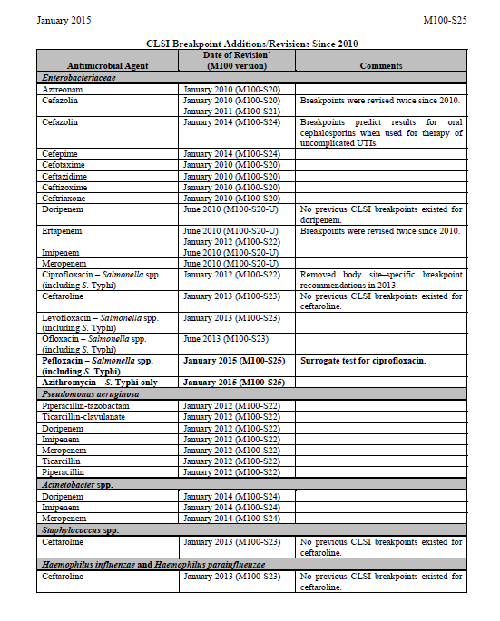
CLSI 2015 M100 document

Slide 38
Why
PK/PD considerations
Elimination of special testing
MHT
ESBL Confirmation

Slide 39
Implications
What do new breakpoints do to your antibiogram?
Do clinicians know about breakpoint changes?
How can we work to communicate and update?

Slide 40
Impact on Antibiogram
 | Escherichia coli |  | Enterobacter cloacae |  | Klebsiella pneumoniae |  | Proteus mirabilis |  | Pseudomonas aeruginosa
 | Prior | Updated | Prior | Updated | Prior | Updated | Prior | Updated | Prior | Updated
Cefazolin | 91% | 79% |  |  | 91% | 85% | 95% | 66%
Ceftriaxone | 91% | 90% | 79% | 73% | 93% | 92% | 97% | 94%
Cefepime | 95% | 93% | 94% | 94% | 93% | 96% | 100% | 100%
Meropenem | 100% | 99% | 94% | 94% | 100% | 100% | 100% | 100% | 81% | 71%
Piperacillin/tazobactam |  |  |  |  |  |  |  |  | 89% | 76%
Internal Data. UAMS.

Slide 41
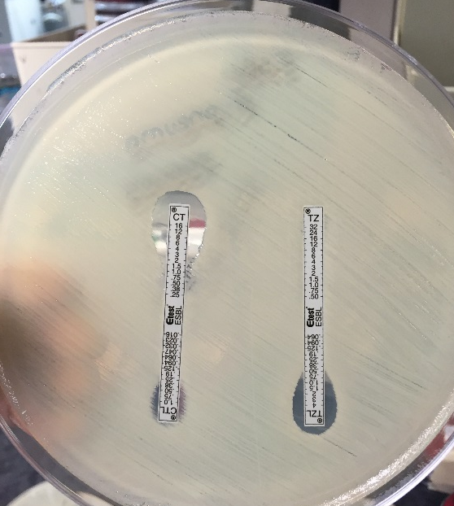
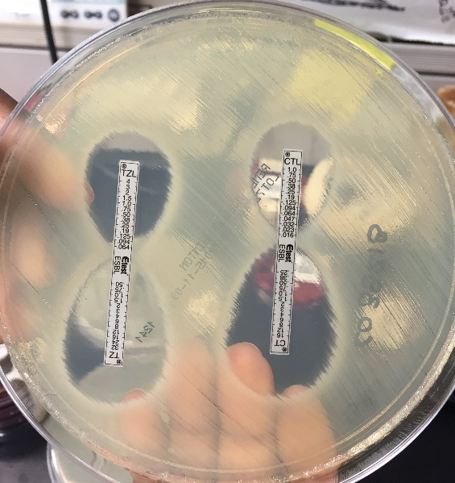
ESBL Impact
Laboratory diagnosis via 3rd gen. cephalosporin resistance
CLSI breakpoint changes make confirmatory tests un-necessary
If not using CLSI breakpoints, E-test based confirmation testing still needed
Rapid diagnostic platforms identify resistance genes
CTX-M
Not comprehensive
Dudley MN, et al. Clin Infect Dis. 2013; 56: 1301-1309.
Notes:
Generally, in a microbiology lab, a lot of the automated testing platforms include an ESBL screen. If the ESBL screen is positive, there is confirmation testing that can be done via a double sided E-test
If new CLSI/FDA breakpoints are used, then a confirmatory test does not need performed per CLSI. They also say that you can just report the MICs as is, without any manual adjustment or flipping of results.
However, the full clinical impact of that recommendation has not been born out, as you may see shortly.

Slide 42
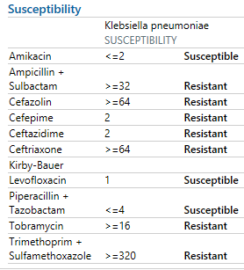
Shift in Interpretation
Examining ESBL E. coli and K. pneumoniae isolates
19.7 – 52.7% of E. coli had S/SDD MICs
29.3 – 58.1% of K. pneumoniae had S/SDD MICs
What are the clinical implications of this change?
McWilliams CS, et al. J Clin Micro. 2014; 52: 2653-2655.
Notes:
There have been some groups that have looked at how these changes would look in practice.
Between two difference studies, there were ranges that 20-53% of ESBL E coli would be in S/SDD range, and 30-60% of ESBL Kleb would be in S/SDD range.
That means you could that have C&S reports that look like the one on the slide….. That now look like this. **Click**
Gone would be any lab language talking about “This is an ESBL”
So if this were in the blood of a kidney transplant patient, how many of you in this room would recommend a carbapenem? How many would recommend Cefepime? How many Ceftazidime? Zosyn?
Okay. Lets see if I can change your minds on cefepime.

Slide 43
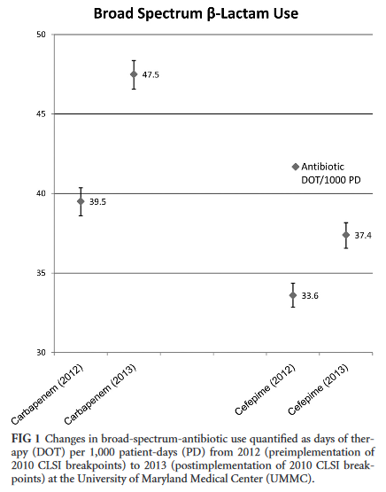
Impact on Antibiotic Usage
New breakpoints: December 2012
After internal verification/validation
Ceftriaxone breakpoint < 4 mcg/mL
3,785 Enterobacteriaceae isolates
Ceftriaxone resistance 18% greater
In Ceftriaxone-R isolates:
37% received carbapenem
31% received cefepime
Heil EL, et al. J Clin Microbiol. 2016; 54(4): 840-4.

Slide 44
Implementing ASP Changes
Design activity that fits your hospital
Review all cultures? Review only blood cultures?
Review all abx?
Build out alerts?
Educate key physician/prescriber staff
Make sure your champion is on board with these recommendations
Change order sets
Default cefepime doses to “SDD” dosing
Guide towards optimal therapy, based on correct antibiogram data
Humphries RM, et al. Clin Infect Dis. 2016; 63 (1): 83-88.
Heil EL, et al. J Clin Microbiol. 2016; 54(4): 840-4.

Slide 45
Implementing ASP Changes
Work with the microbiology lab – implementing new breakpoints is possible…
Update AST cards when new ones are available
Ask to be notified when new cards are under consideration
Look at the MIC ranges on the cards!
Software updates
Vitek 8.01
Microscan
Implement new breakpoints through validation
Humphries RM, et al. Clin Infect Dis. 2016; 63 (1): 83-88.
Heil EL, et al. J Clin Microbiol. 2016; 54(4): 840-4.
https://www.biomerieux-microbio.com/solutions/vitek-2-software-update-makes-lab-workflow-smoother-than-ever/

Slide 46
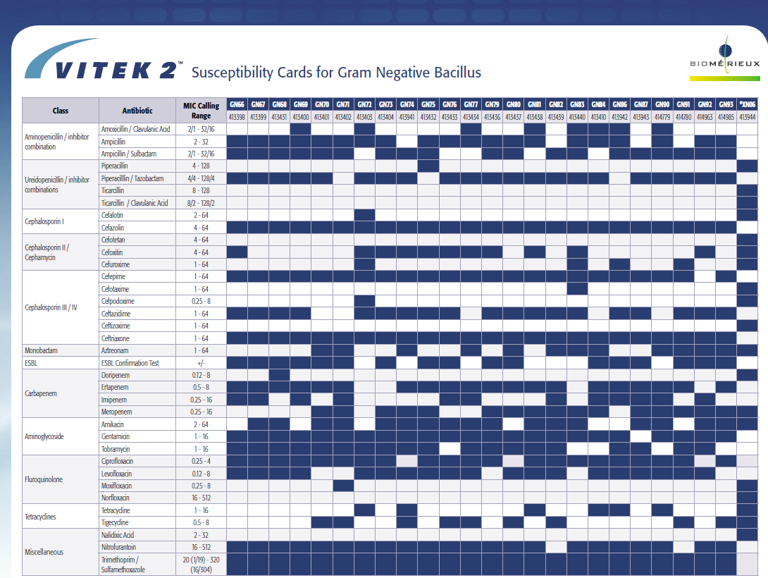
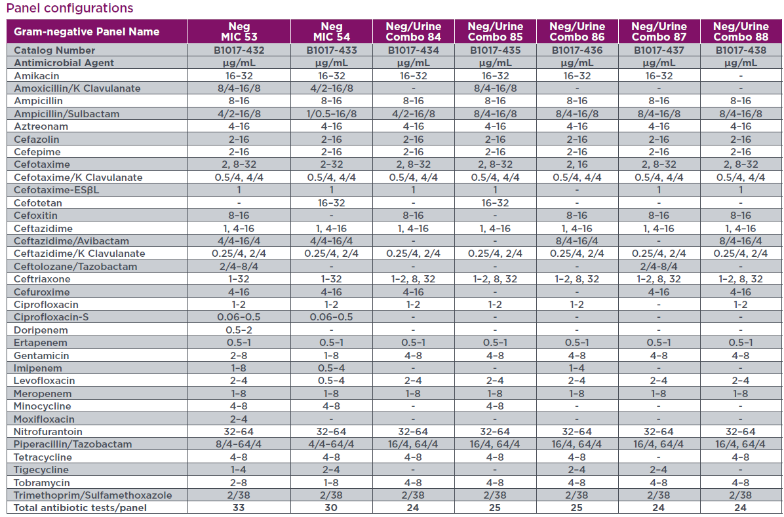
Card Selection
Vitek and Microscan documents

Slide 47
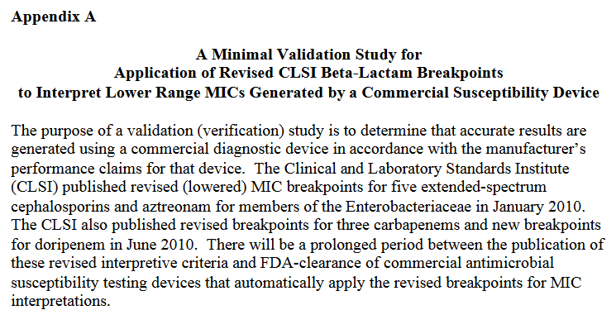
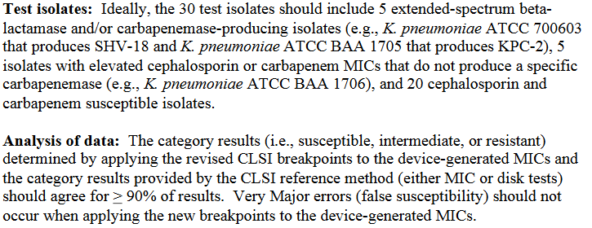
Updates Through Validation
https://www.idsociety.org/Topics_of_Interest/Antimicrobial_Resistance/Professionals/Antimicrobial_Susceptibility_Testing/

Slide 48
Before Going Down to the Lab…
QC and Validation processes
CLSI M52: Verification of Commercial Microbial Identification and Antimicrobial Susceptibility Testing Systems

Slide 49
Questions
Which of the following drugs has had CLSI and FDA revised breakpoints for Pseudomonas since 2009?
A. Cefepime
B. Aztreonam
C. Piperacillin/tazobactam
D. Gentamicin

Slide 50
Questions
Which of the following is NOT true regarding the SDD susceptibility category:
A. It applies to cefepime for Enterobacteriaceae
B. It is an FDA designation
C. It can be interpreted as “intermediate”
D. It accounts for PK/PD parameters to dictate dose

Slide 51
Thank You!
Special thanks to Nicole Emery, MS (UAMS Micro Lab)
Contact information
Katie Lusardi, PharmD, BCPS-AQ ID
Pharmacy Clinical Specialist, Antimicrobial Stewardship
KTLusardi@uams.edu

Slide 52
AMS Examples
Leading to Improvements in Resistance and MICs at St. Bernards Medical Center

Slide 53
Improving Treatment of Extended Spectrum Beta-lactamase (+) Organisms
Interventions
Changes in Microbiology
Incorporated “ESBL +” into the organism name for easier distinction of multi-drug resistant organism when reviewing current or previous culture history
Automatically changed culture and susceptibility (C&S) results to guide therapy decisions
Utilizing clinical decision support
Receive real-time alerts on all positive cultures including ESBL (+) organisms and for patients re-admitted with a previous ESBL (+) culture result
Educating healthcare providers
ESBL = Extended Spectrum Beta-Lactamase

Slide 54
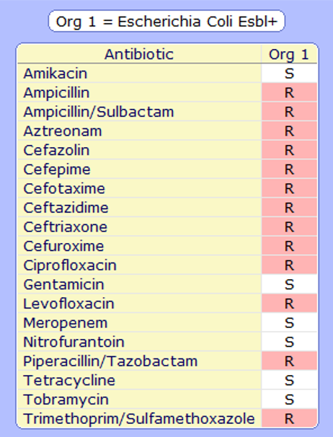
ESBL (+) Microbiology Interventions

Slide 55
ESBL (+) Intervention Outcomes: Appropriate Treatment
Evaluation
6 months pre- and post-intervention
Outcomes: Empiric Therapy
Appropriate therapy if antibiotic ordered within 24 hours of admission that was effective based on the most recent ESBL positive organism C&S results
*Prior to intervention, ESBL (+) organisms were not specifically labeled on the microbiology C&S results
Outcomes: Targeted Therapy
Appropriate therapy if ordered within 24 hours of the final C&S results, organism susceptible, and appropriate for site of infection

Slide 56
ESBL (+) Intervention Outcomes: Halted Increasing Percentage of ESBLs?

Slide 57
What Other Risk Factors for ESBL Infection Should Be Considered?
Healthcare exposure
Hospitalization, long-term care residence, hemodialysis, intravascular catheter¹
Community exposure
Recent antibiotics, corticosteroid usage, PEG tube¹
Antibiotics
US veterans with spinal cord injury²: fluoroquinolones, 3rd and 4th generation cephalosporins
Japan³: aminoglycosides, tetracyclines, fluoroquinolones, TMP/SMX, 2nd and 4th generation cephalosporins
Thailand⁴: cephalosporins, beta-lactam/beta-lactamase inhibitors
Increased risk of colonization with ESBL-producing Enterobacteriaceae
Travel to Asia¹
Netherlands⁵: proton pump inhibitor usage?
¹Munoz-Price, L.S. (2018). Extended-spectrum beta-lactamases. In A. Bloom (Ed.), UpToDate. Retrieved September 19, 2018. ²Infect Control Hosp Epidemiol 2016;37:768-776. ³J Infect Chemother. 22 (2016) 319-326. ⁴Southeast Asian J Trop Med Public Health. 2016 Mar;47(2):227-33. ⁵Clin Infect Dis. 2017;64(3):36 1-3.

Slide 58
Impact of Vancomycin Loading Doses on MRSA Vancomycin MICs
Intervention
Loading doses for all adult patients receiving Vancomycin unless the first dose already administered
25 mg/kg (max 2 grams)
Evaluation
Retrospective Inpatient Data
Pre-Intervention (Jan 2011 – Nov 2013) and Post-Intervention (Dec 2013 – Sept 2016)
Primary Endpoint
Mean Vancomycin minimum inhibitory concentration (MIC) values for MRSA
Secondary Endpoints
Vancomycin usage defined as mean days of therapy (DOT) per 1000 patient days
Acute kidney injury (AKI) defined as ≥ 0.3 mg/dL increase in SCr within 48 hours after administering 1st dose of Vancomycin

Slide 59
Vancomycin Loading Dose Outcomes: MRSA Vancomycin MICs
Primary Endpoint Results
Mean MIC between both periods (1.64 vs 1.65, p=0.94)
Mean MIC increased during the pre-intervention period (coefficient = 0.007, p<0.001)
Mean MIC decreased during the post-intervention period (coefficient = -0.007, p=0.006)
*****Vancomycin loading dose intervention is associated with a decrease in mean MIC of approximately 0.01 each month*****

Slide 60
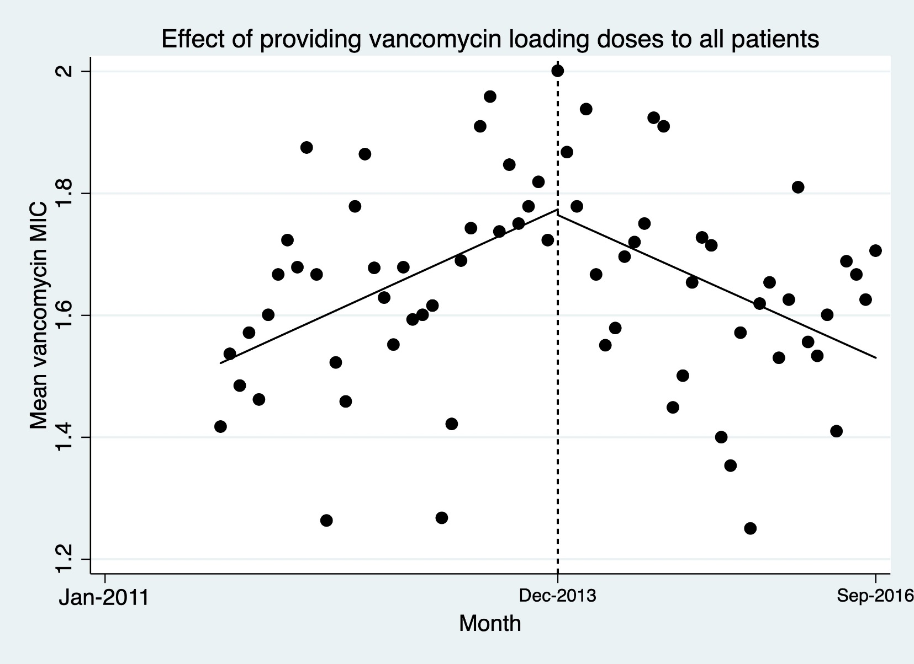
Lower MRSA Vancomycin MICs - Post Loading Doses in All Vancomycin Patients
Pre-intervention MICs
(35 months) n=858
Post-intervention
MICs
(34 months)
n=688

Slide 61
Vancomycin Loading Dose Outcomes: Vancomycin Usage and AKI Incidence
Secondary Endpoint Results
Mean Vancomycin DOT/1000 patient days between both periods (62.86 vs 63.03, p=0.92)
Vancomycin DOT/1000 patient days decreased during the pre-intervention period (coefficient = -0.315, p=0.005)
Vancomycin DOT/1000 patient days leveled off during the post-intervention period (coefficient = -0.066, p=0.574)
Mean AKI incidence between both periods (6.6 vs 5.8, p=0.652)

Slide 62
Vancomycin Loading Dose Outcomes: Vancomycin MICs vs. DOT/1000 Pt Days

Slide 63
Patient Encounters
2011-2016
n=1,127
After excluding HD and without baseline SCr
n=442
Post-intervention
2013-2016 (34 months)
n=534
After excluding HD and without baseline SCr
n=466
Pre-intervention
2011-2013 (35 months)
n=593
Included remaining encounters with SCr ≥ 0.3 mg/dL increase within 48hr after 1st Vanc dose
n=29
Included remaining encounters with SCr ≥ 0.3 mg/dL increase within 48hr after 1st Vanc dose
n=27
Vancomycin Loading Dose Outcomes: AKI Occurrence
p=0.652

Slide 64
Microbiology Factors to Consider in Analysis of AMS Efforts
Testing Methods
Typically ensure only 1st isolate of organism from a specific patient is included during analysis period
Inquire if Microbiology has changed testing methods, instruments, or panels that could impact analysis of AMS efforts
Etest vs. Automated Susceptibility Testing (AST) Methods for MRSA Vancomycin MICs
Literature varies (studies using fresh vs frozen samples may impact results¹)
Etest may be more reliable in predicting treatment response²
Broth Microdilution (BMD), Etest, and AST MRSA Vancomycin MICs³
Absolute agreement in Vancomycin MICs compared with BMD
Phoenix (66.2%), Microscan turbidity (61.8%), Vitek 2 (54.3%)
Etest produced MIC values 1 to 2 dilutions higher than those produced by the BMD method (36.7% agreement)
Over call MIC = 1mg/L → MicroScan (74.1%)
Under call MIC = 2mg/L → Phoenix (76%) and Vitek 2 (20%)
¹J Clin Microbiol. 2012 Feb;50(2):318-25. ²Int J Antimicrob Agents . 2008;32(5):378-85. ³J Clin Microbiol. 2013 Jul;51(7):2077-81. ⁴Diagn Microbiol Infect Dis. 2015 Oct;83(2):93-8.

Slide 65
Questions
Which of the following should be considered in analysis of inpatient AMS efforts on MICs/resistance?
CLSI vs. FDA breakpoints utilized
Instrument/panel changes
Outside factors (e.g., outpatient antibiotic usage)
All of the above

Slide 66
Thank You!
Special Thanks to Jacob Painter, PharmD, PhD for statistical analysis
Contact information
Marsha Crader, PharmD
Pharmacy Clinical Specialist
Antimicrobial Stewardship Lead Pharmacist
mcrader@sbrmc.org

Slide 67
Get Smart Week
November 12-18, 2017
Now called U.S. Antibiotic Awareness Week
Multiple resources on the CDC website and more coming from ADH

Slide 68
Questions

