Slide 1
Personal Finance 101
By: Brandon Johnson
Financial Advisor

Slide 2
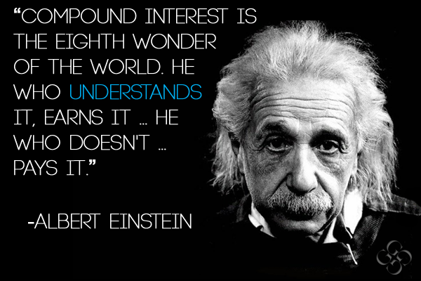

Slide 3
4 Areas of Planning (Financial Security)
Protect Your Income
Debt Reduction
Savings
Retirement

Slide 4
1. Protect Your Income
Emergency Fund: 3 to 6 months Fixed Expenses in Savings at all times
Short-Term Disability Insurance
Long-Term Disability Insurance
Life Insurance

Slide 5
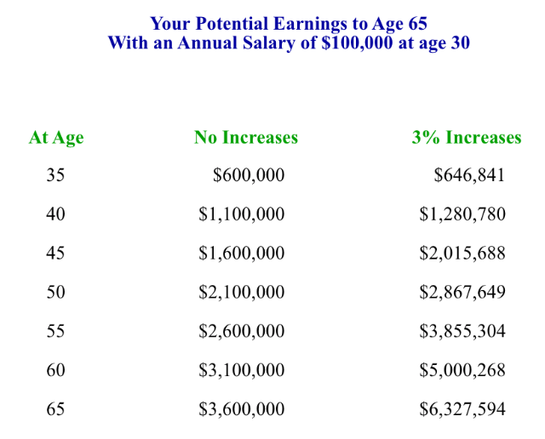
Your Greatest Asset = Your ability to earn a substantial income over your career

Slide 6
Life Insurance
DIME Theory: Debt, Income Replacement, Mortgage & Education
Yes, Mortgage is a form of debt but if we took out mortgage then it would be the DIE Theory
Term Life Insurance
Permanent Life Insurance
Universal Life Insurance

Slide 7
2. Debt Reduction
Debt = Enemy of Saving
Debt causes Stress
Having a debt game plan = Stress reliever

Slide 8
Debt Reduction Steps
Balance Sheet
Budget
Are there places in my budget that I can cut back on?
Am I living beyond my means?
Monthly Cash Flows Statement

Slide 9
Budget
Form

Slide 10
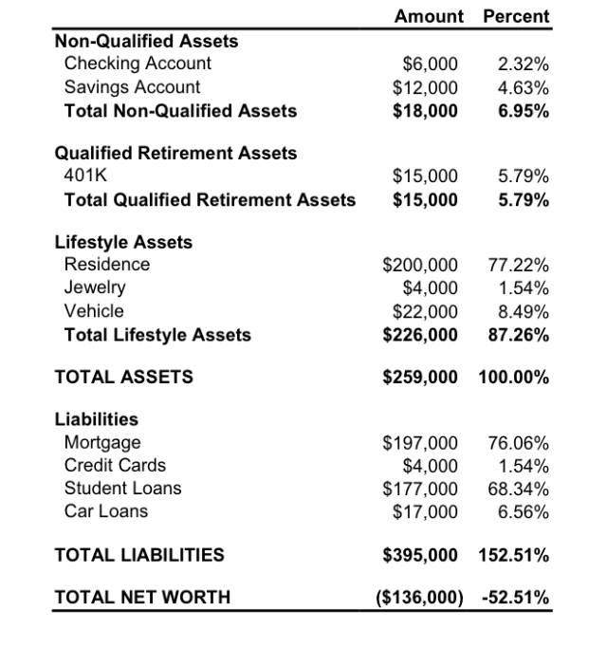
Balance Sheet
Example

Slide 11
Monthly Cash Flow Statement (Example)
After-Tax Income: $6,000
Monthly Expenses: $4,500
Discretionary Income: $1,500

Slide 12
3. Savings
Emergency Fund
Short Term Sickness/Disability (3 months)
To access in retirement when the market is down when we shouldn’t be taking from our Qualified Accounts
Can keep us at a lower tax bracket in retirement

Slide 13
4. Retirement
Start as soon as possible
Participate in your Employer Plan (Get the match!)
Difference in Traditional / Roth
Investor Profile

Slide 14
Compound Interest: How much do I need to save now (monthly) to have $1 Million at age 65?
Age Monthly $ Amount
381
30 555
35 820
40 1,235
3,155
*Assuming 7% Annual ROR

Slide 15
My Information
Brandon Johnson
brandon.j@nm.com
Cell: (870)476-3078
Office: (870) 935-6900

